Slide 1
CMPA SCHEME
Dec 2023 – May 2024
Non-Targeting Fish Species

Slide 2
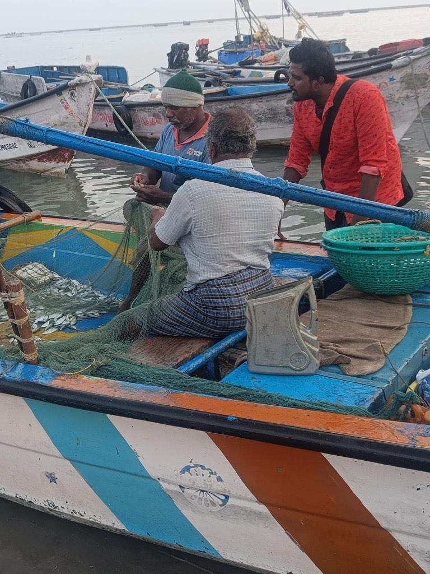
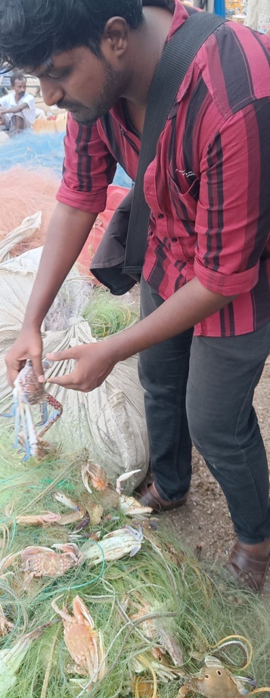
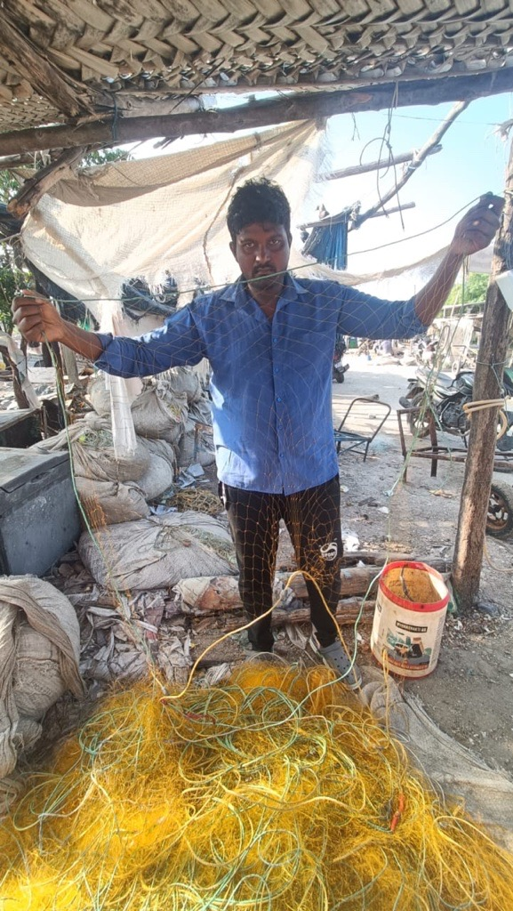
VILLAGES
DEVIPATTINUM
KARANKADU
THONDI

Slide 3
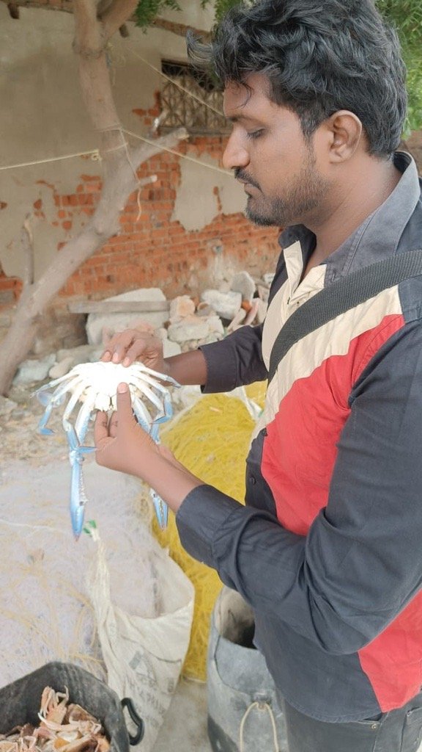
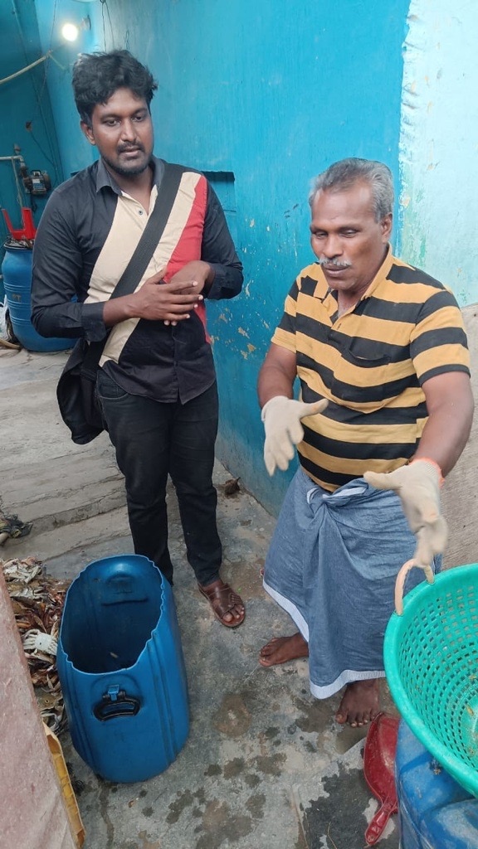
VILLAGES
PASIPATTINUM
MUTHUKUDA

Slide 4
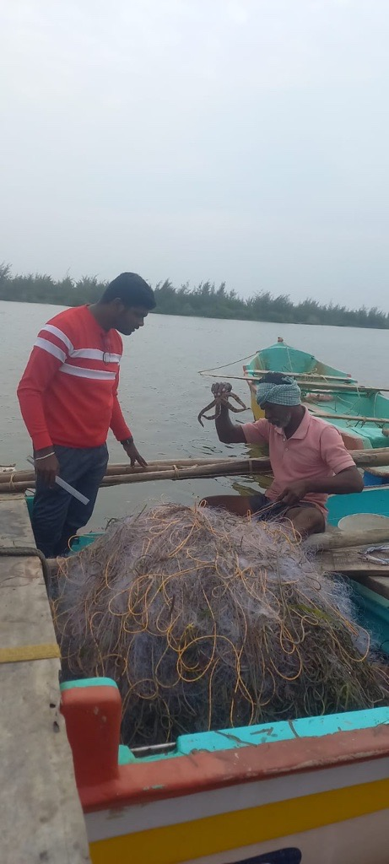
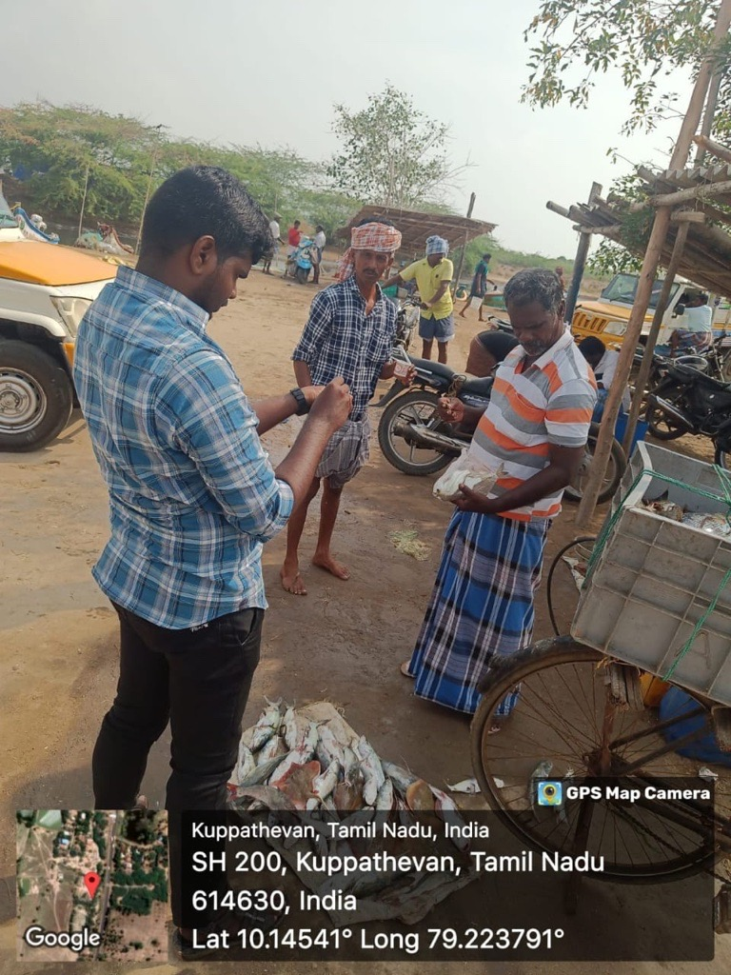
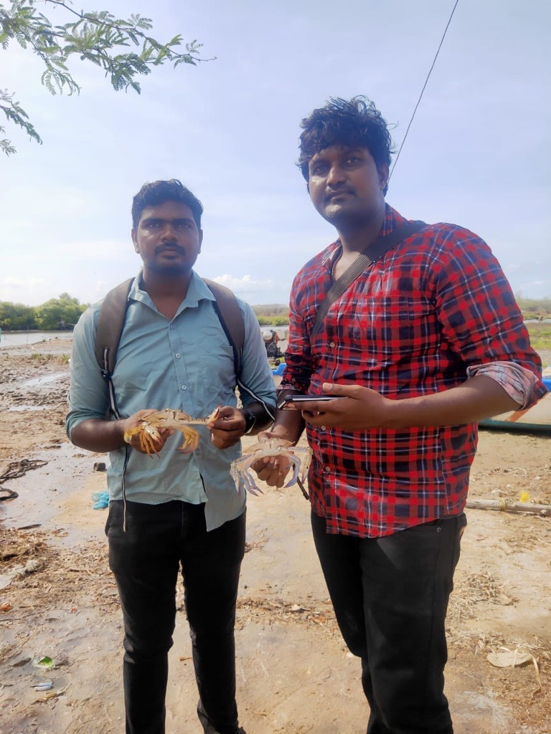
VILLAGES
KOLLUKADU
SENTHALAIPATTINAM
KRISHNAJIPATTINAM

Slide 5
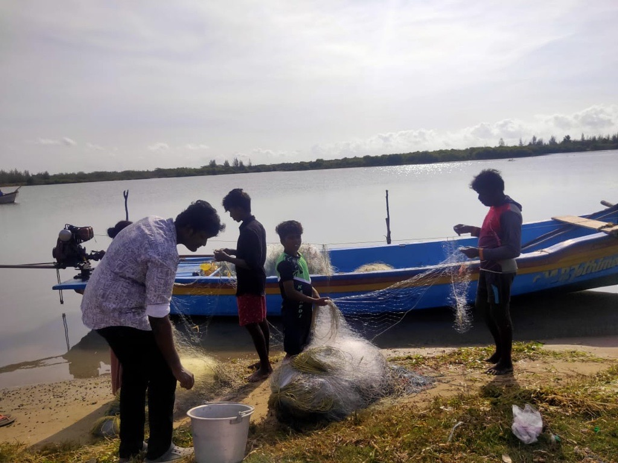
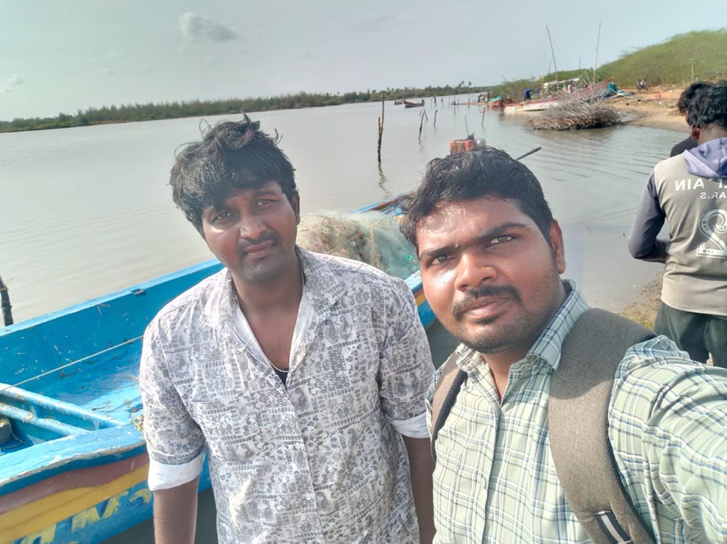
VILLAGES
PONNAGARAM
SAMBAIPATTINAM

Slide 6
Non target Finfishes found in the Region
Serial number | species | Family | Order | Local Name
1 | Eleutheronema tetradactylum | polynemidae | Perciformes | Kala Meen
2 | caranx sexfaciatus | carangidae | Perciformes | Muntakannu paarai
3 | Platycephalus indicus | platycephalidae | Perciformes | Naakku meen, Serruppu meen
4 | Silago sigama | Silaginidae | Perciformes | Killaikhan meen
5 | Psammoperca waigiensis | latidae | Perciformes | Roggu meen
6 | Gerres filamentosus | gerridae | Perciformes | Ootagam meen
7 | Sphyraena forsteri | Sphyraenidae | Perciformes | Olli meen
8 | Siganus javus | siganidae | Perciformes/ acanthuriformes | Koolaa meen
9 | Scatophagus argus | Scatophagidae | Perciformes/ Acanthuriformes | Pulli Ellathi meen
11 | Drepane punctata | Drepaneidae | Acanthuriformes | Eillathi meen
12 | Upeneus bensasi | Mullidae | Mulliformes | Loomeya meen
13 | Upeneus moluccensis | Mullidae | Mulliformes | Loomeya meen

Slide 7
Non target Finfishes found in the Region
Serial number | species | Family | Order | Local name
14 | Plicoffollis platystomus | Aridae | Siluriformes | Kelluthi meen
15 | Nemapteryx caelata | Aridae | Siluriformes | Kelluthi meen
16 | Plotosus canius | plotosidae | siluriformes | Theylee meen
17 | Platybelone argalus | belonidae | Beloniformes | Kolliya mural
18 | Hyporhamphus dussumieri | hemiramphidae | Beloniformes | Kolliya mural
19 | pelates uadrilineatus | teraponidae | Centrarchiformes | Keeli meen
20 | Pseudotriacanthus strigilifer | triacanthidae | Tetradontiformes | Keelathi meen
21 | Cynoglossus cynoglossus | cynoglossidae | Pleuronectiformes | Naakku meen, ooti meen
22 | Etroplus suratensis | chichlidae | Chichliformes | Kurruvalai meen
23 | Chanos chanos | chanidae | Gonorynchiformes | Paal sura
24 | Atule mate | carangidae | Carangiformes | Manja maththi
25 | Chiloscyllium griseum | hemiscyllidae | Orectolobifomes | Kurangu sura , thalan sura
26 | Neotrygon indica | dasyatidae | Mylobatiformes | Thirrukai meen
27 | Sepia pharaonis | sepiidae | sepiida | Oottu kanavai meen

Slide 8
Non target Shellfishes found in the Region
Serial number | species | Family | Order | Local name
1 | Turbinella pyrum | Turbinellidae | Neogastopoda | sangu
2 | Pectan | Pectinidae | Pectinida | Varri sippi
3 | lambis | Strombidae | Littorinimorpha | I viral sangu
4 | Margistrombus marainatus | Strombidae | Littorinimorpha | Sangu sippi
5 | Tonna dolium | Tonnidae | Littorinimorpha | Varri sangu
6 | oratosquilla interrupta | Squillidae | Stomatopoda | Kadal Purran/ Elee Poochi
7 | Paphia | Veneridae | Venerida | sippi
8 | Penaeus monodon | penaeidae | Decopoda | irral
9 | Portunus sanguinolentus | Portunidae | Decapoda | Monnu pulli nandu
10 | Charybdis feriata | Portunidae | Decapoda | Silluvai nandu
11 | Charybdis hellri | Portunidae | Decapoda | Neechal nandu
12 | Metacarcinus magister | Cancridae | Decapoda | Biscuit nandu
13 | Charybdis natator | Portunidae | Decapoda | Paarai nandu
14 | Scylla serrata | Portunidae | Decapoda | Kal nandu

Slide 9
ETP species found in the Region
Serial number | species | Family | Order | Local name
1 | Holothuria scabra | holothuridae | holothuriida | Kadal attai
2 | Hippocampus kellogi | Sygnathidae | Sygnathiformes | kadalkuthirai
3 | Hippocampus kuda | Sygnathidae | Sygnathiformes | Kadal kuthirai

Slide 10
Non target Finfishes found in the Region

Slide 11
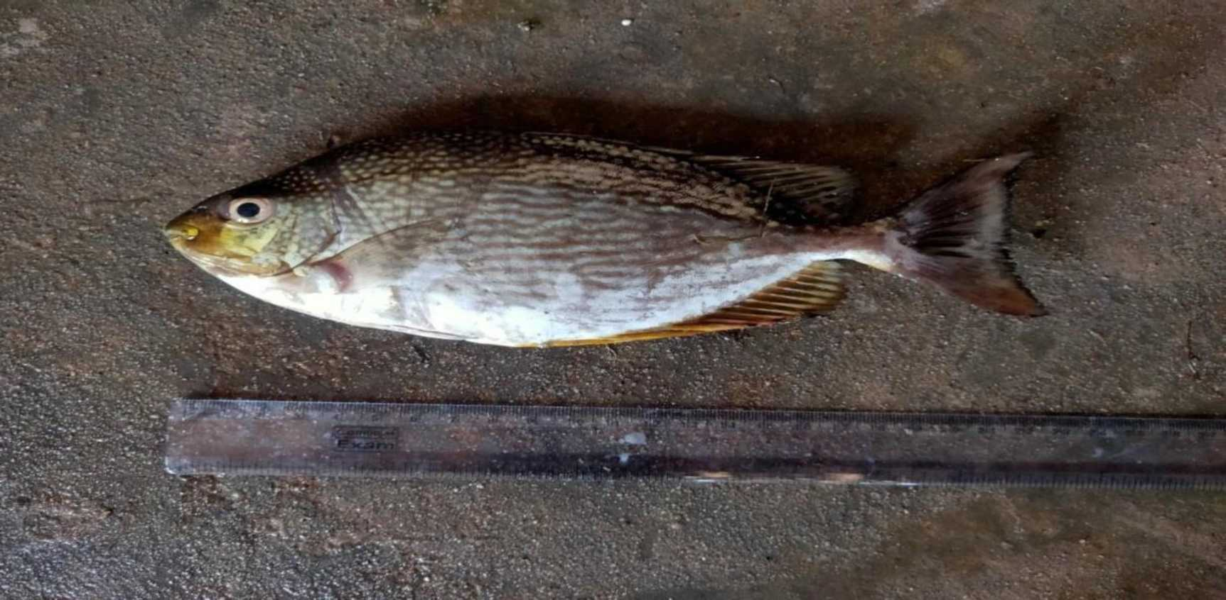
Siganus javus

Slide 12
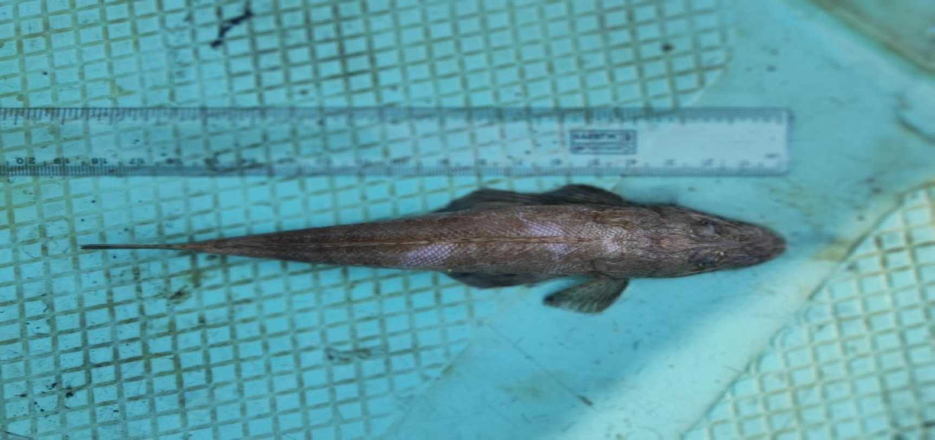
Platycephalus indicus

Slide 13
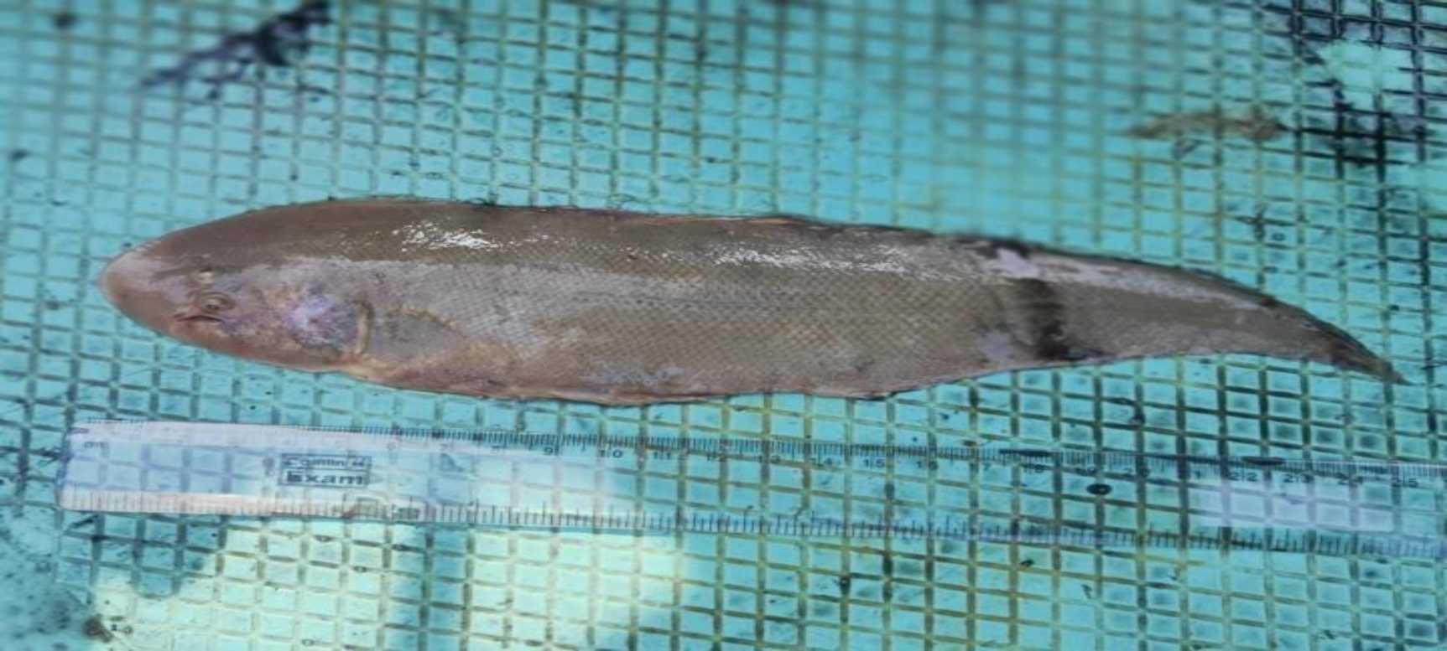
Cynoglossus cynoglossus

Slide 14
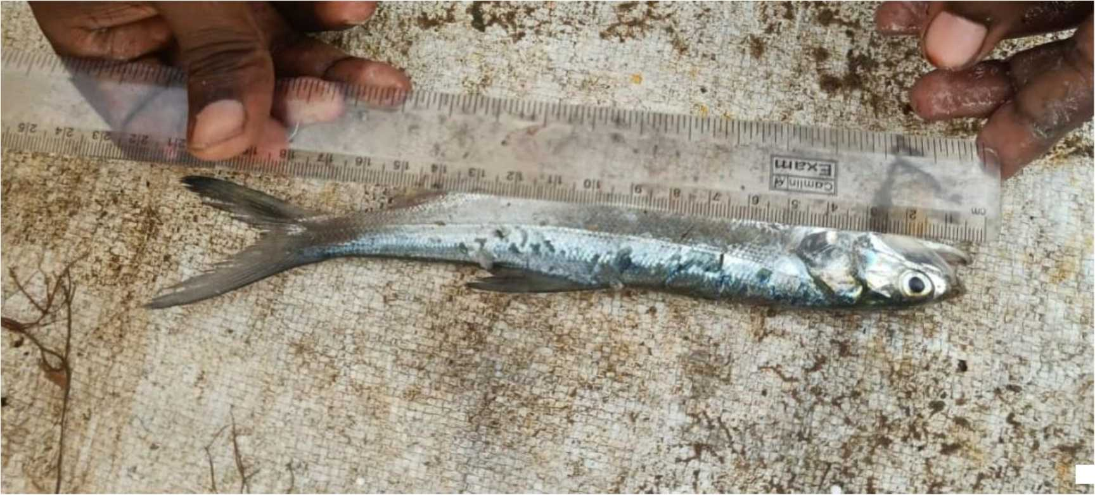
soireip sotret

Slide 15
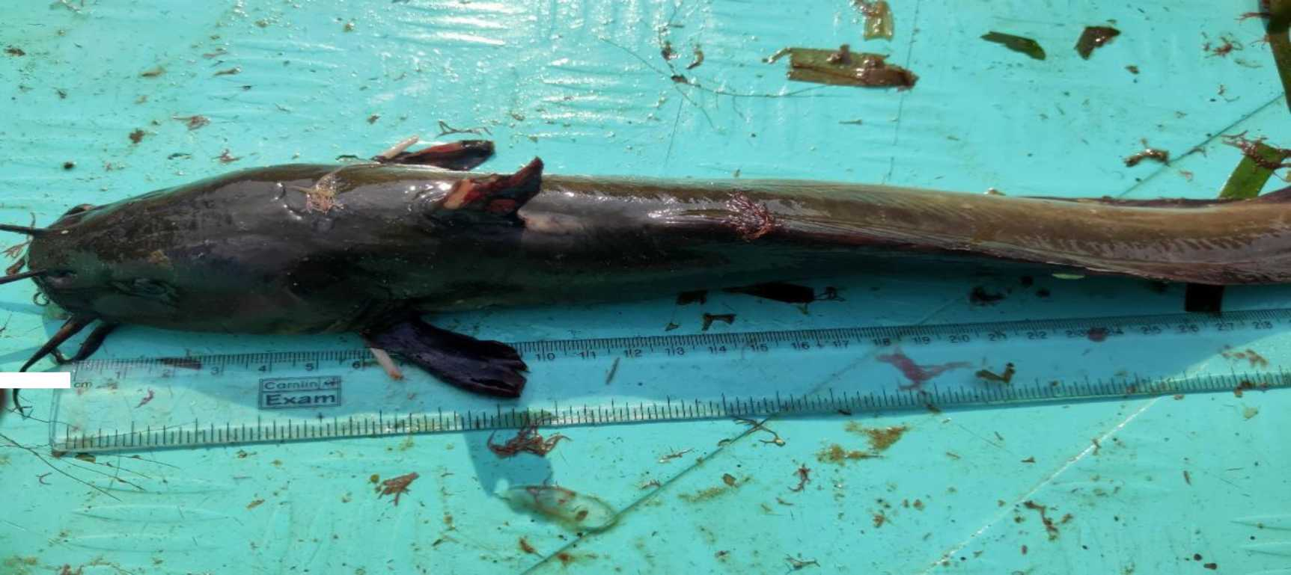
Plotosus canius

Slide 16
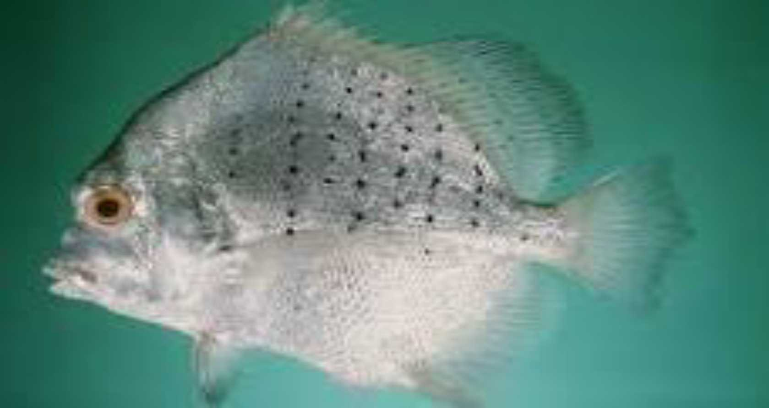
Drepane punctata

Slide 17
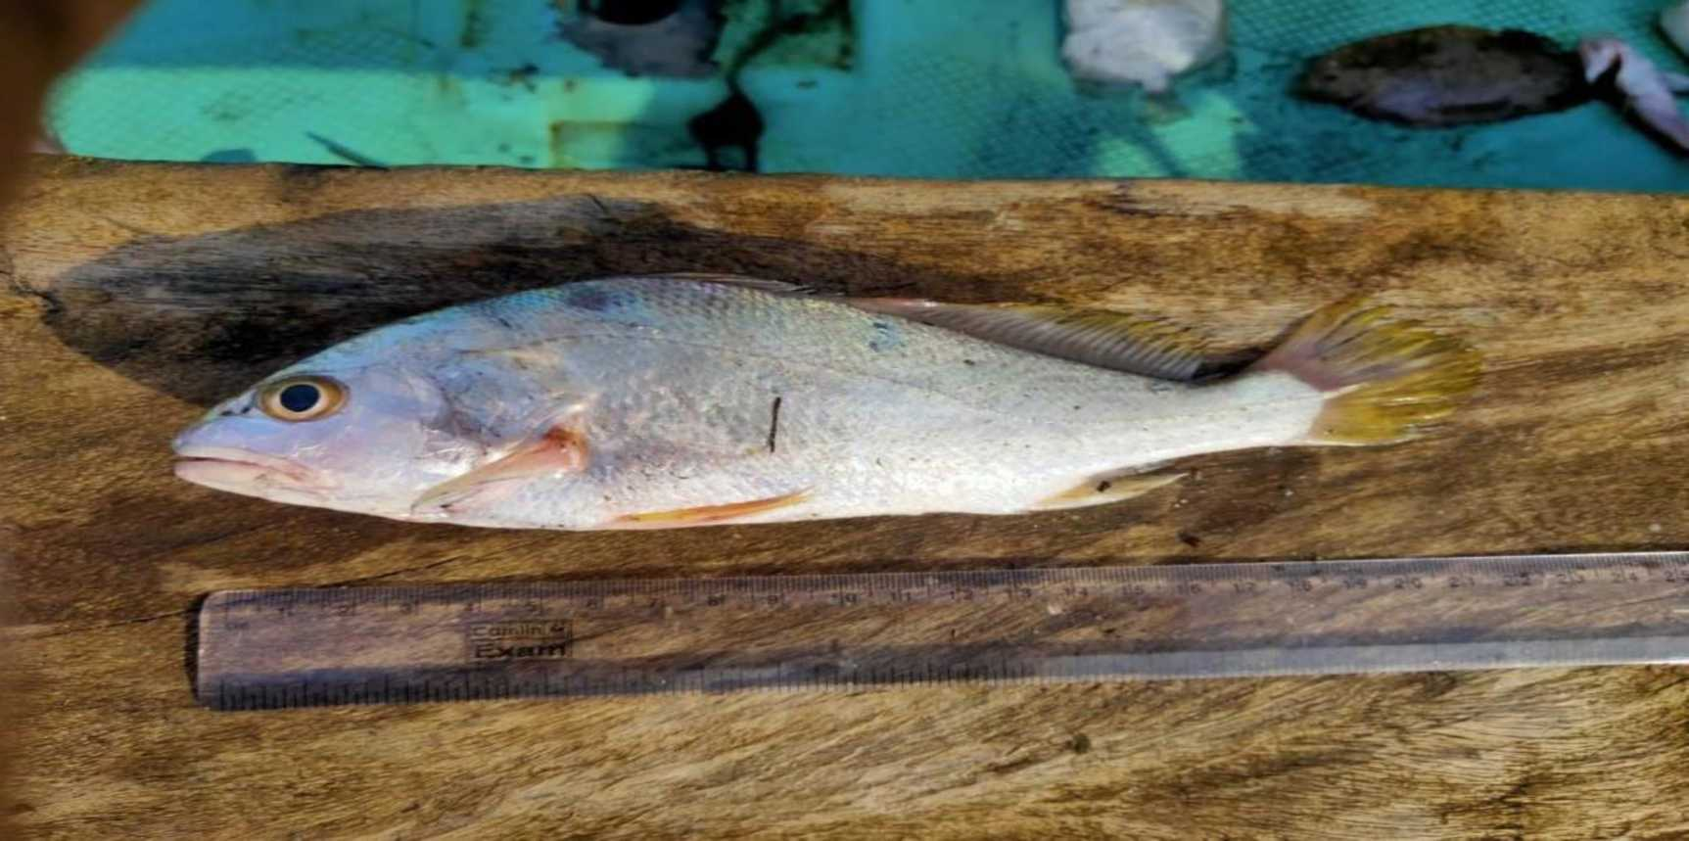
Pennahia argentata

Slide 18
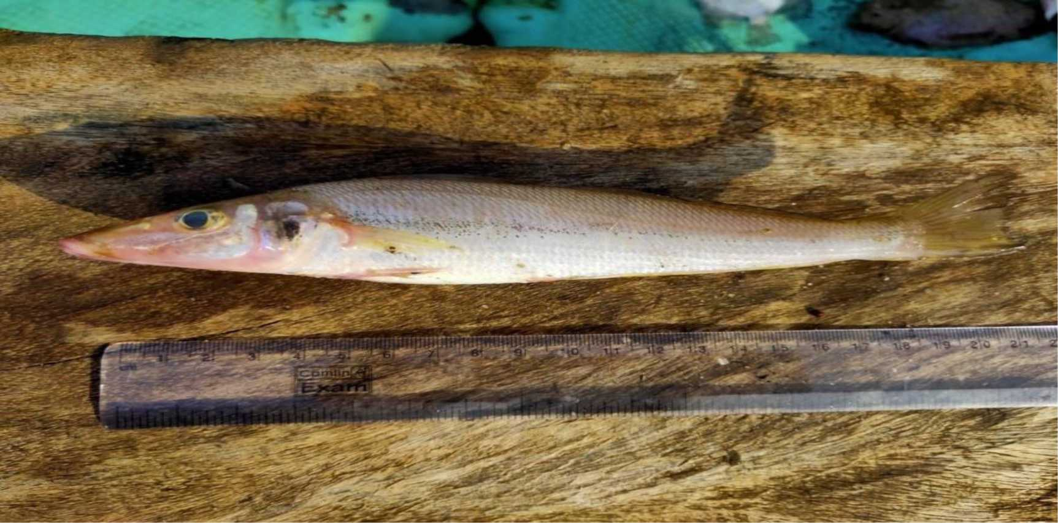
Silago sigama

Slide 19
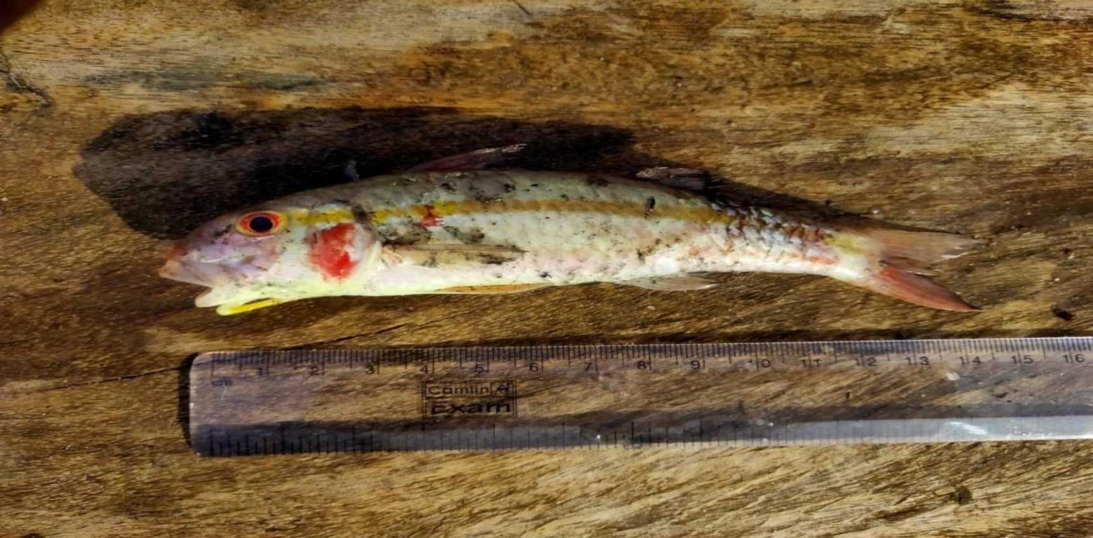
Upeneus moluccensis

Slide 20
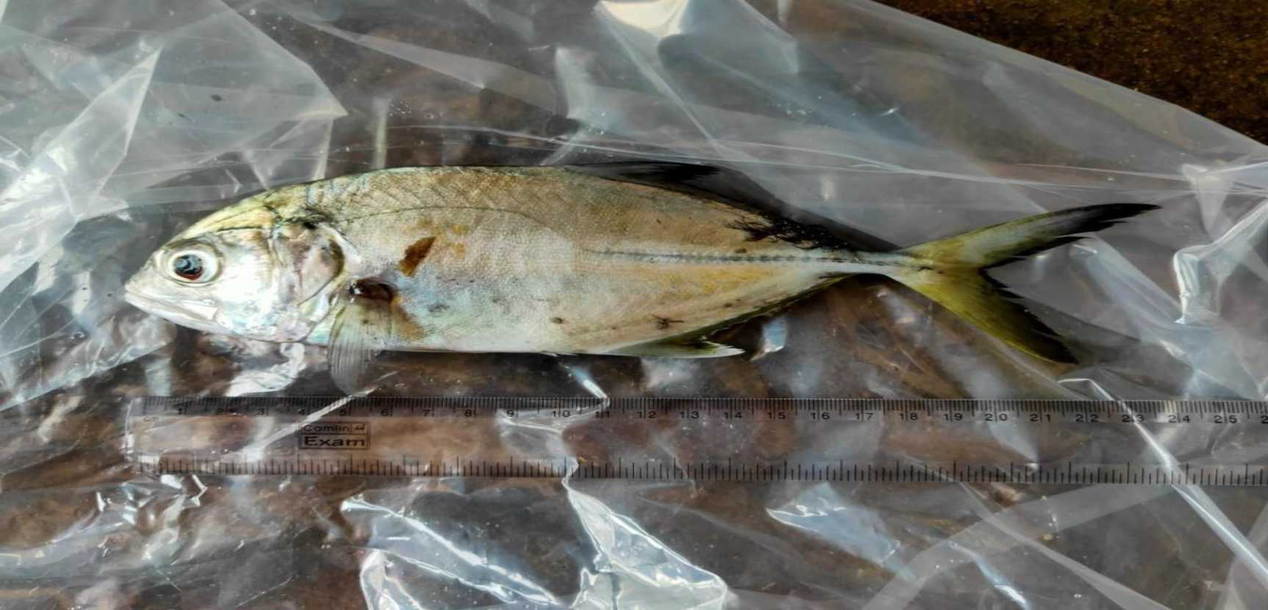
caranx sexfaciatus

Slide 21
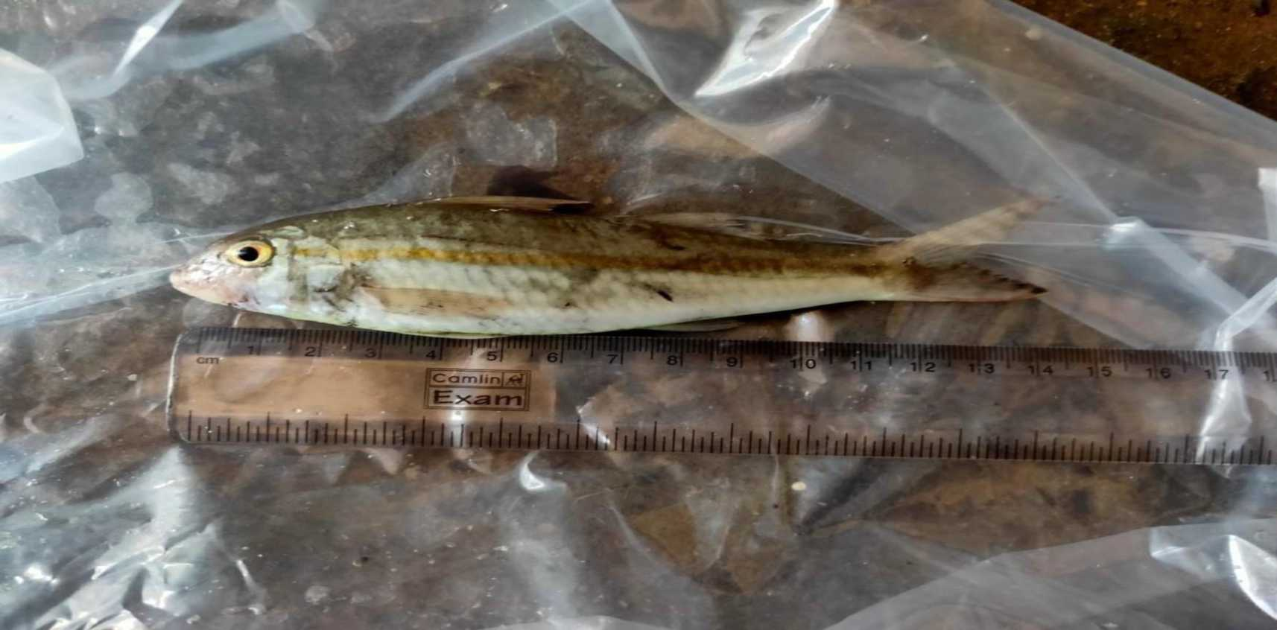
Upeneus bensasi

Slide 22
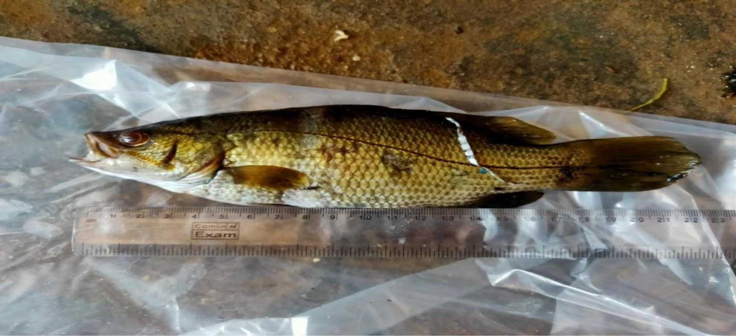
Psammoperca waigiensis

Slide 23
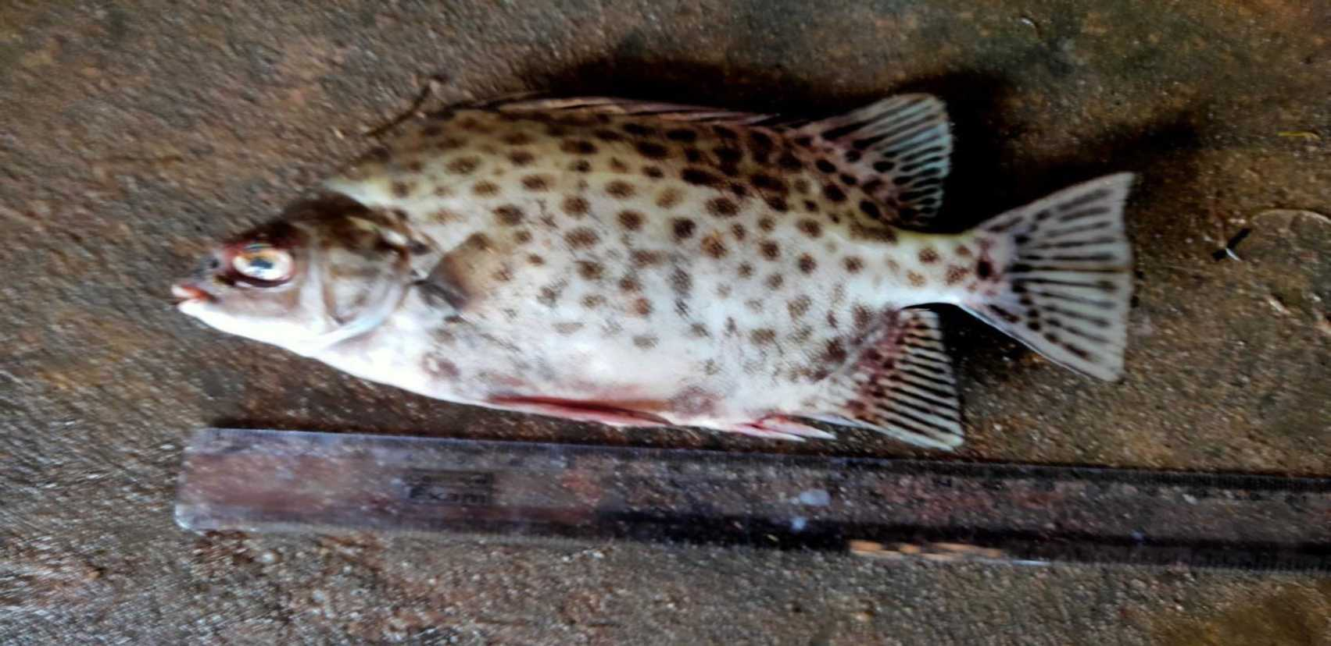
Scatophagus argus

Slide 24
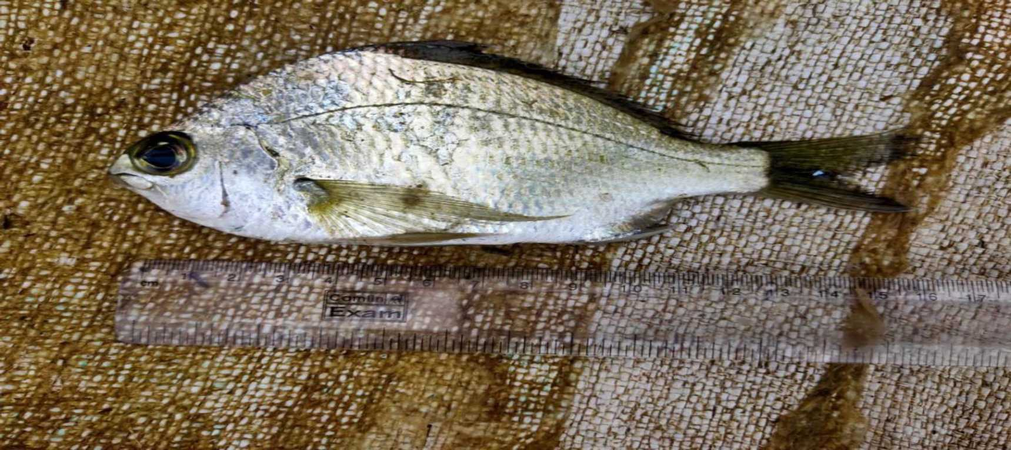
Gerres filamentosus

Slide 25
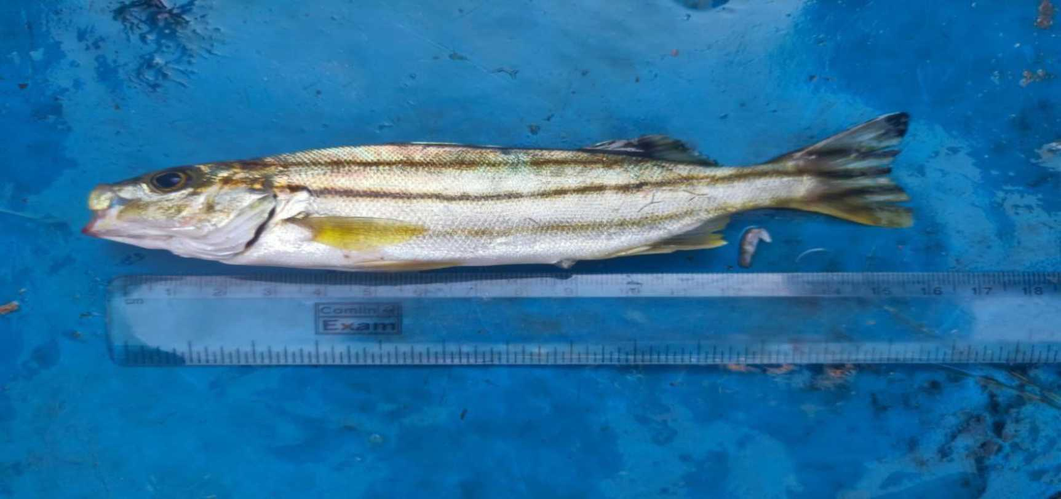
pelates uadrilineatus

Slide 26
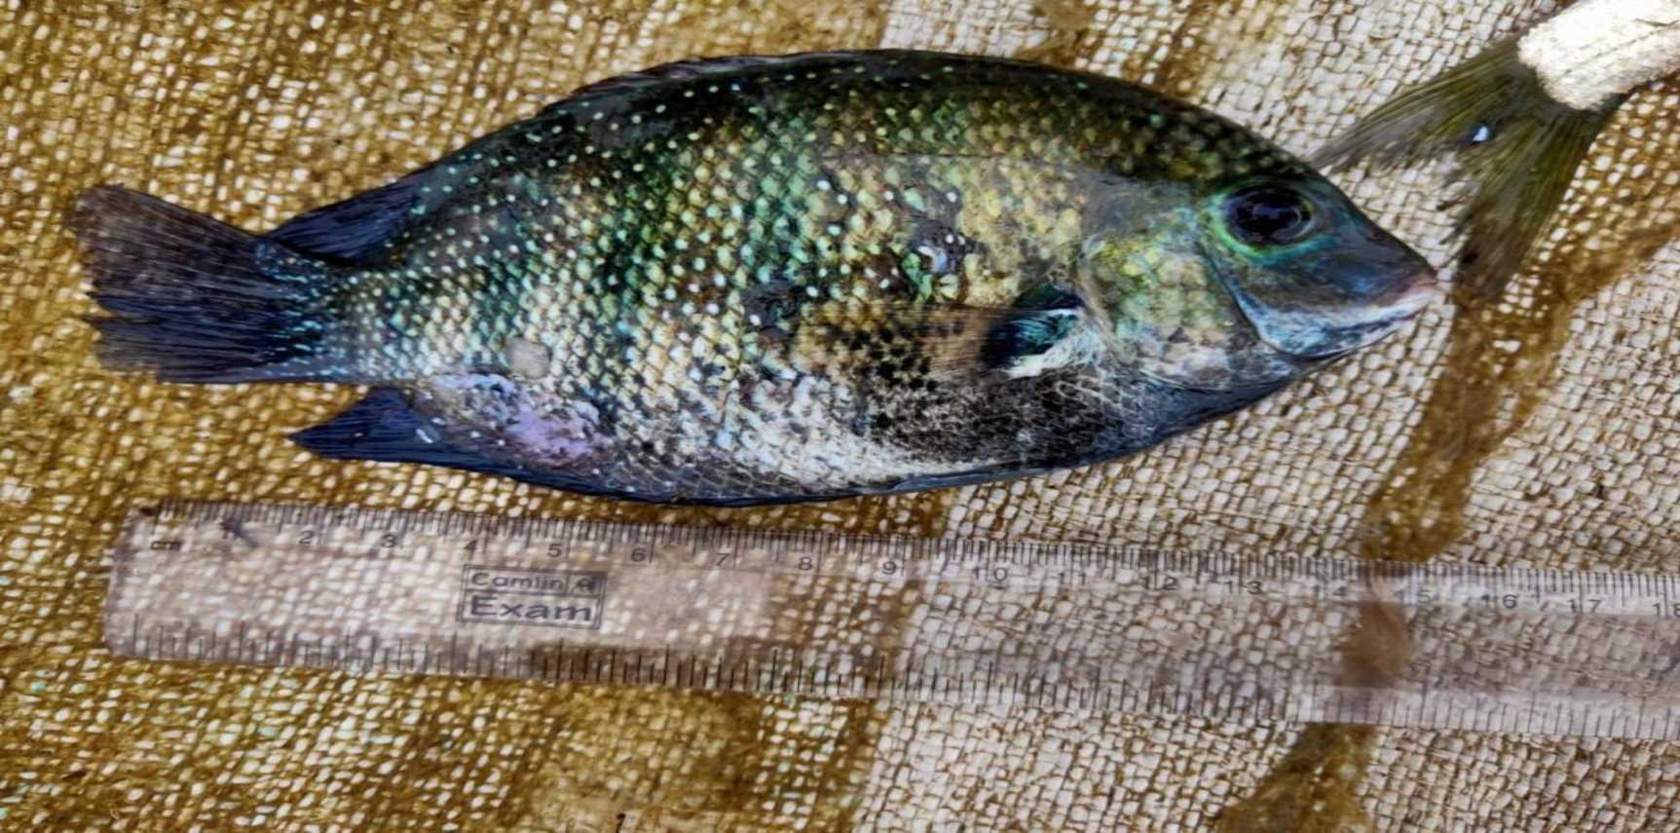
Etroplus suratensis

Slide 27
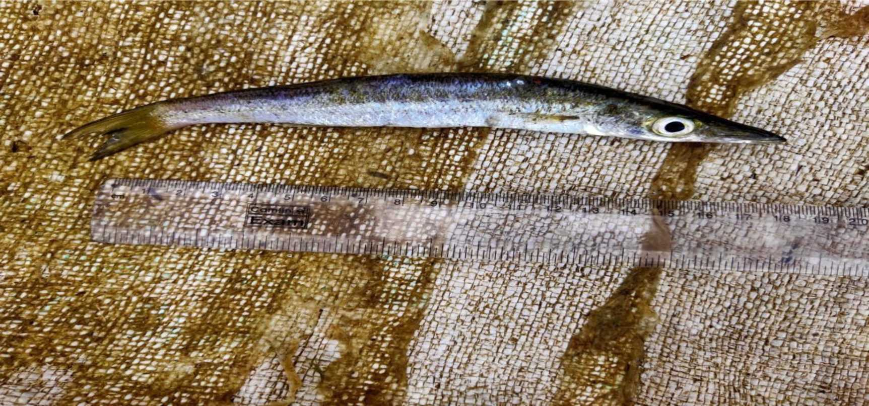
Sphyraena forsteri

Slide 28
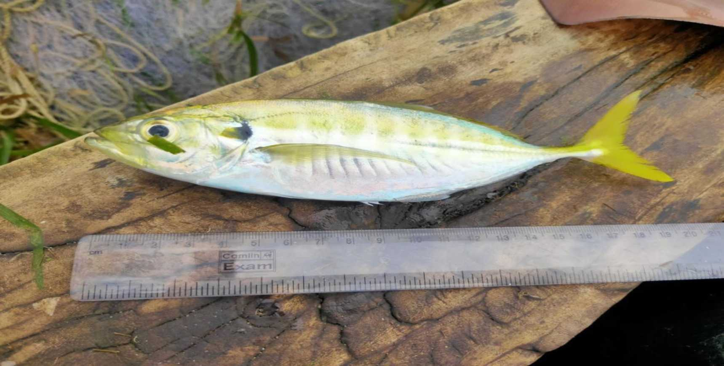
Atule mate

Slide 29
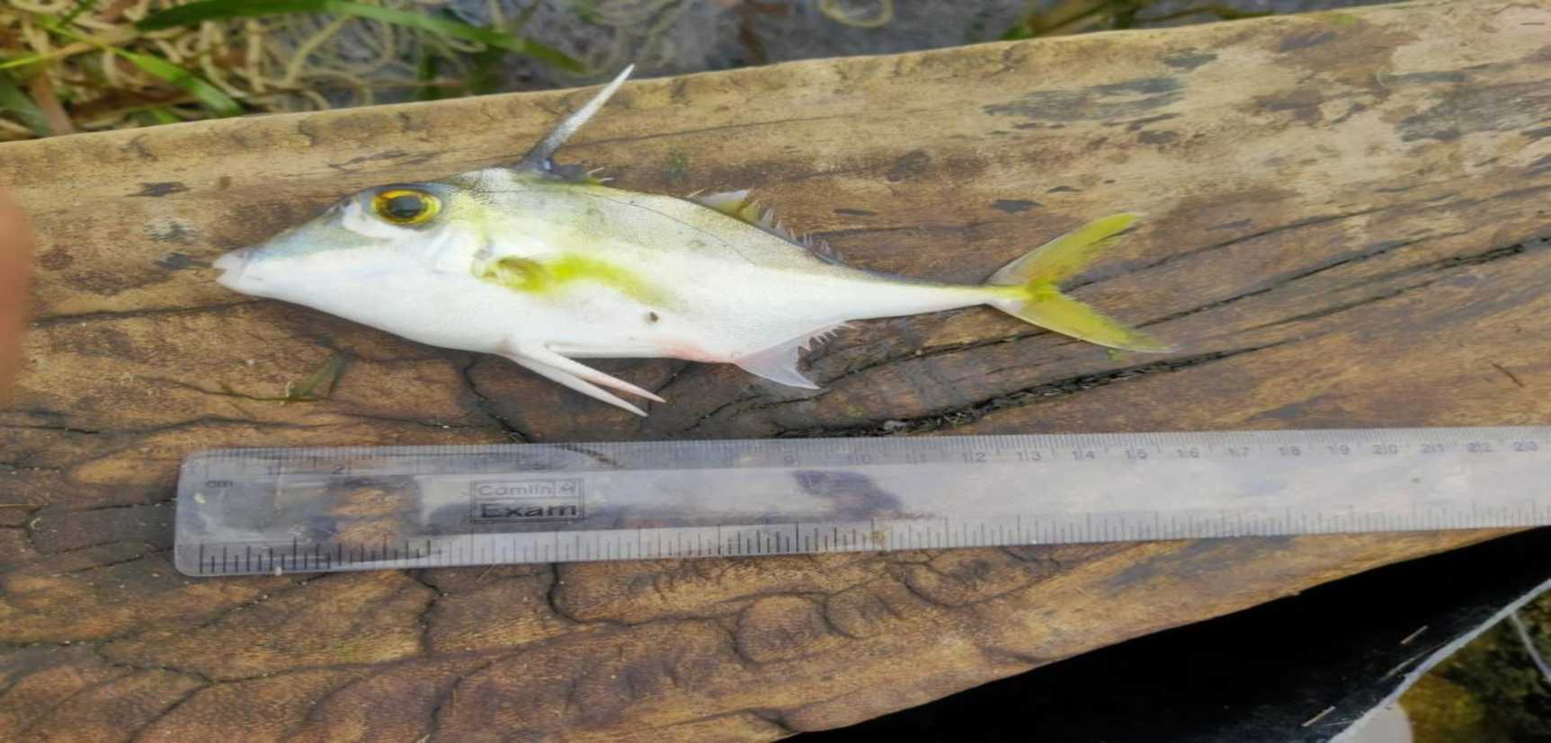
Pseudotriacanthus strigilifer

Slide 30
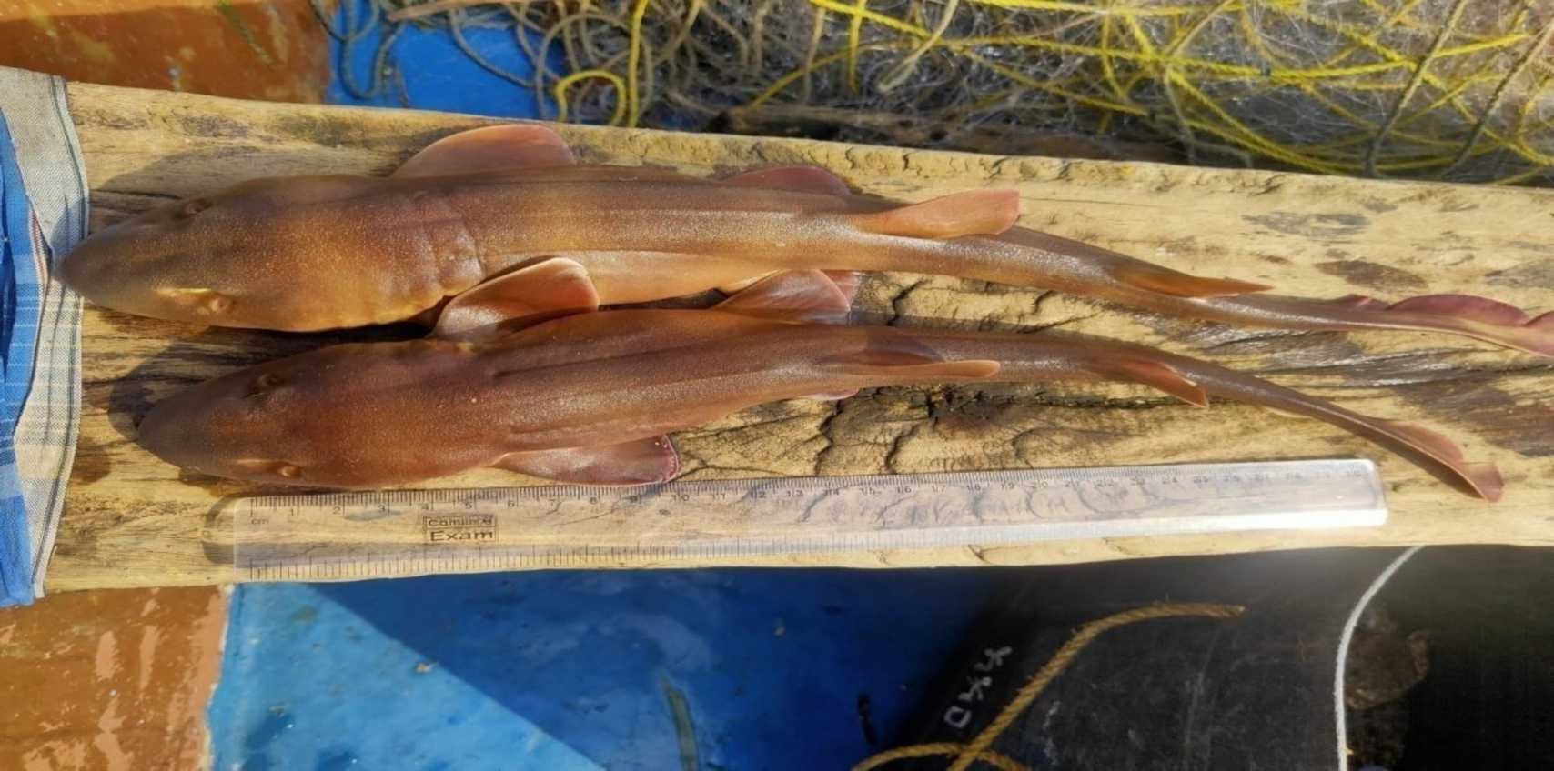
Chiloscyllium griseum

Slide 31
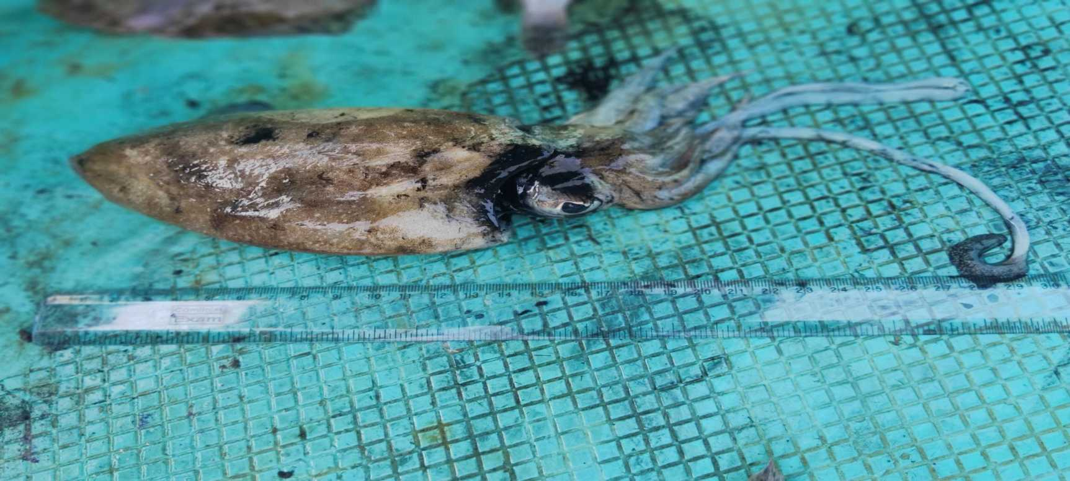
Sepia pharaonis

Slide 32
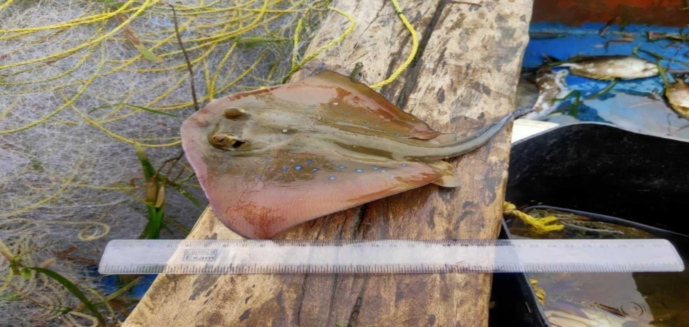
Neotrygon indica

Slide 33
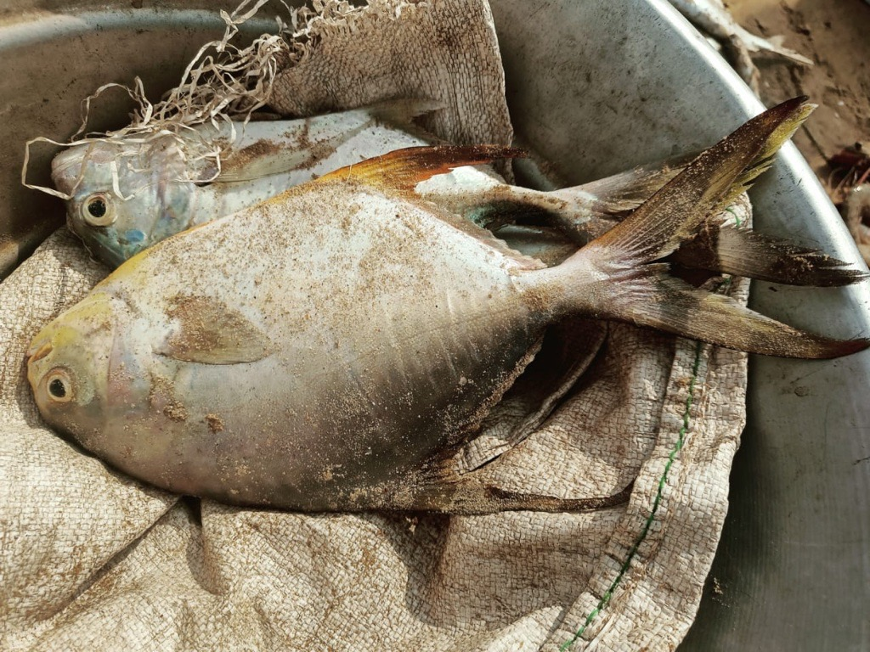
Trachinotus mookale

Slide 34
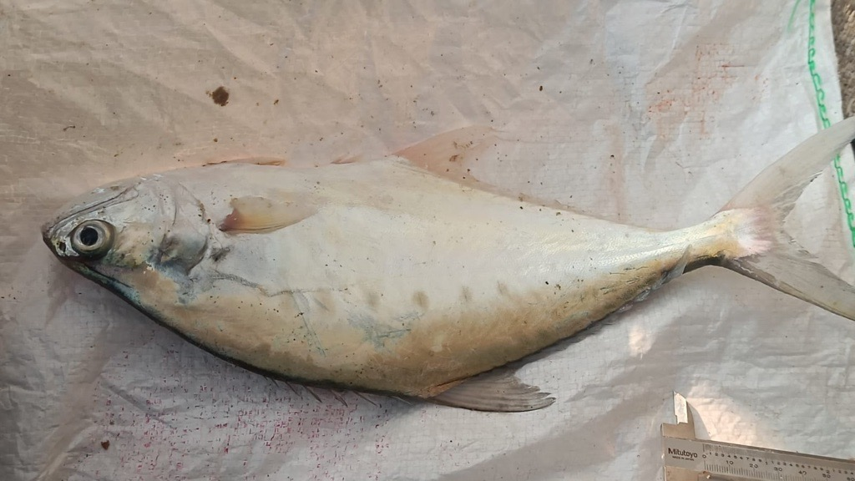
Scomberoides commersonianus

Slide 35
Non target Shellfishes found in the Region

Slide 36
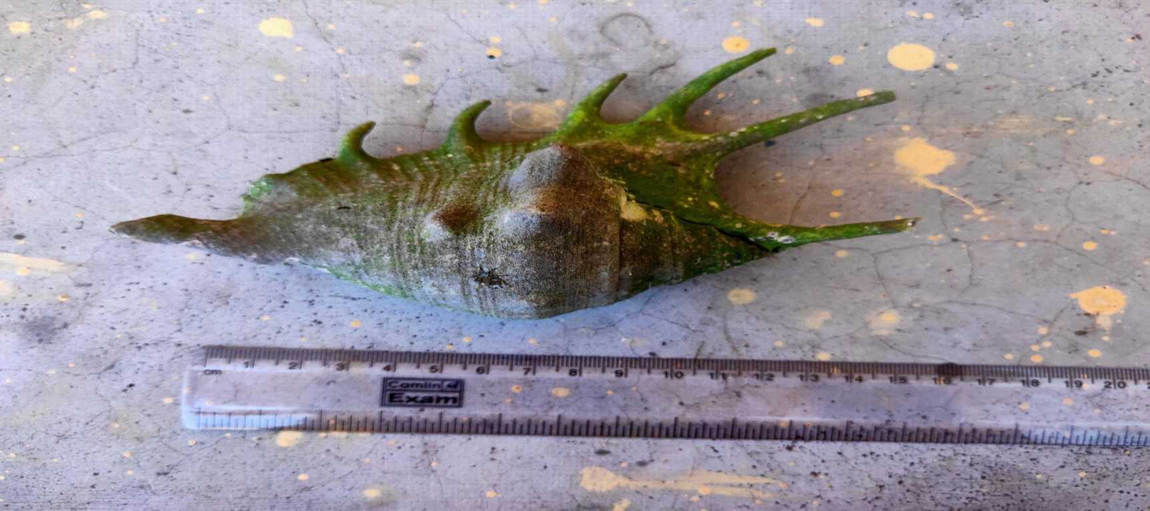
Lambis

Slide 37
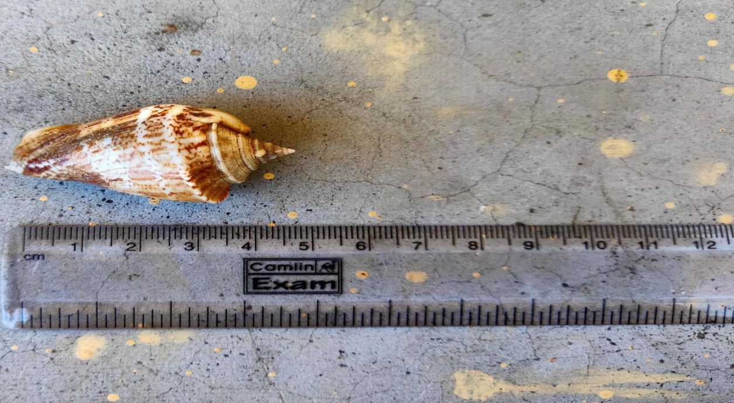
Margistrombus marainatus

Slide 38
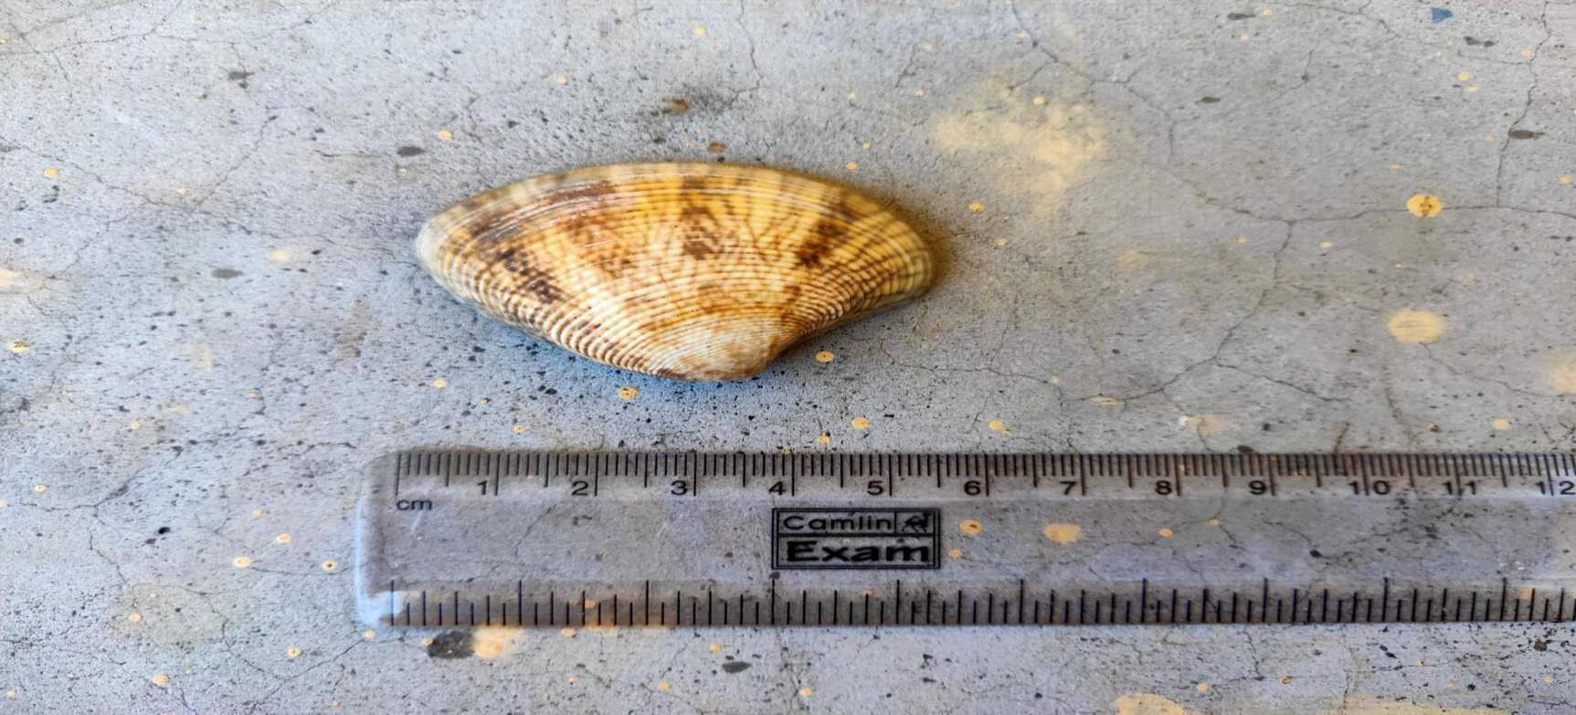
Paphia

Slide 39
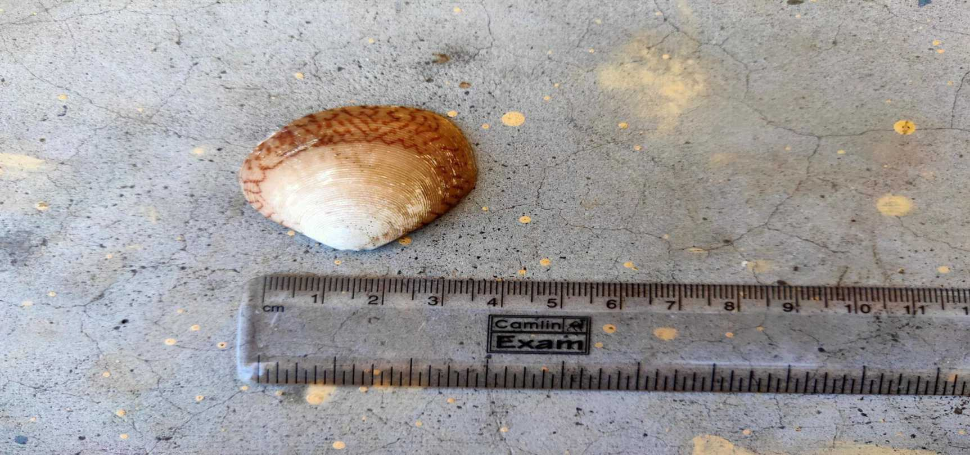
Paphia

Slide 40
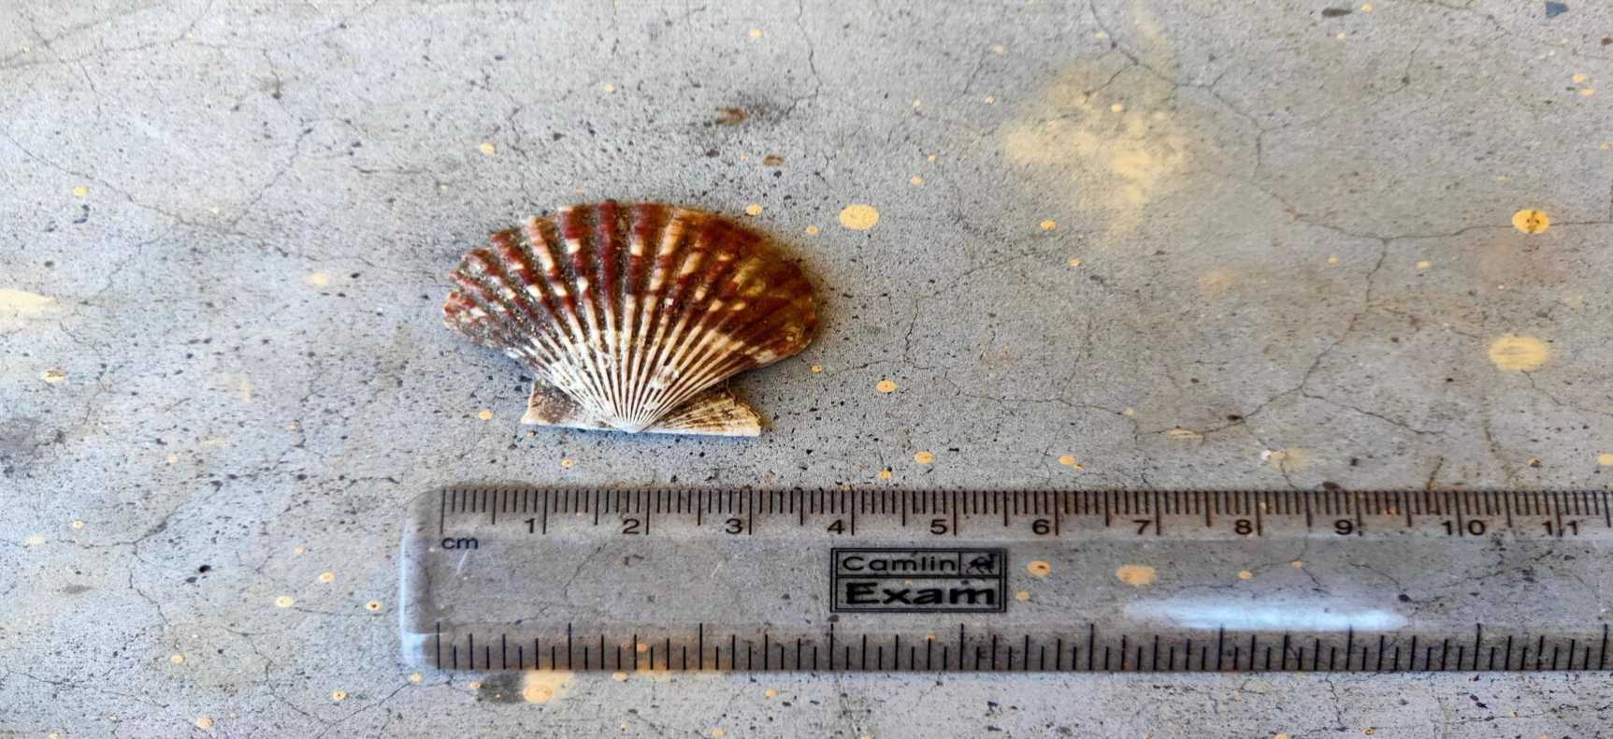
Pectan

Slide 41
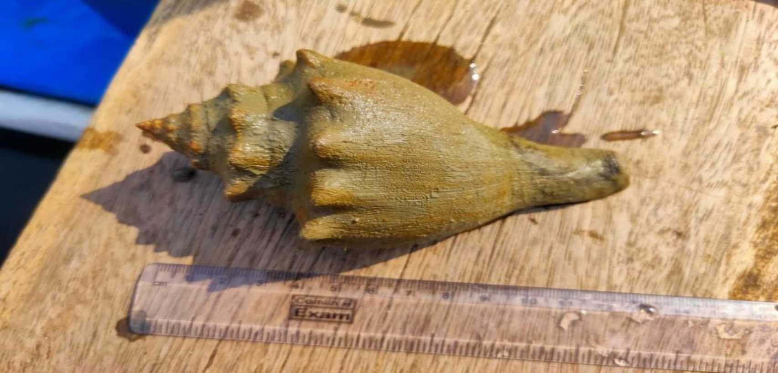
Turbinella pyrum

Slide 42
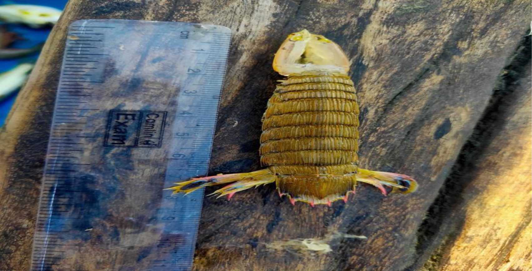
oratosquilla interrupta

Slide 43
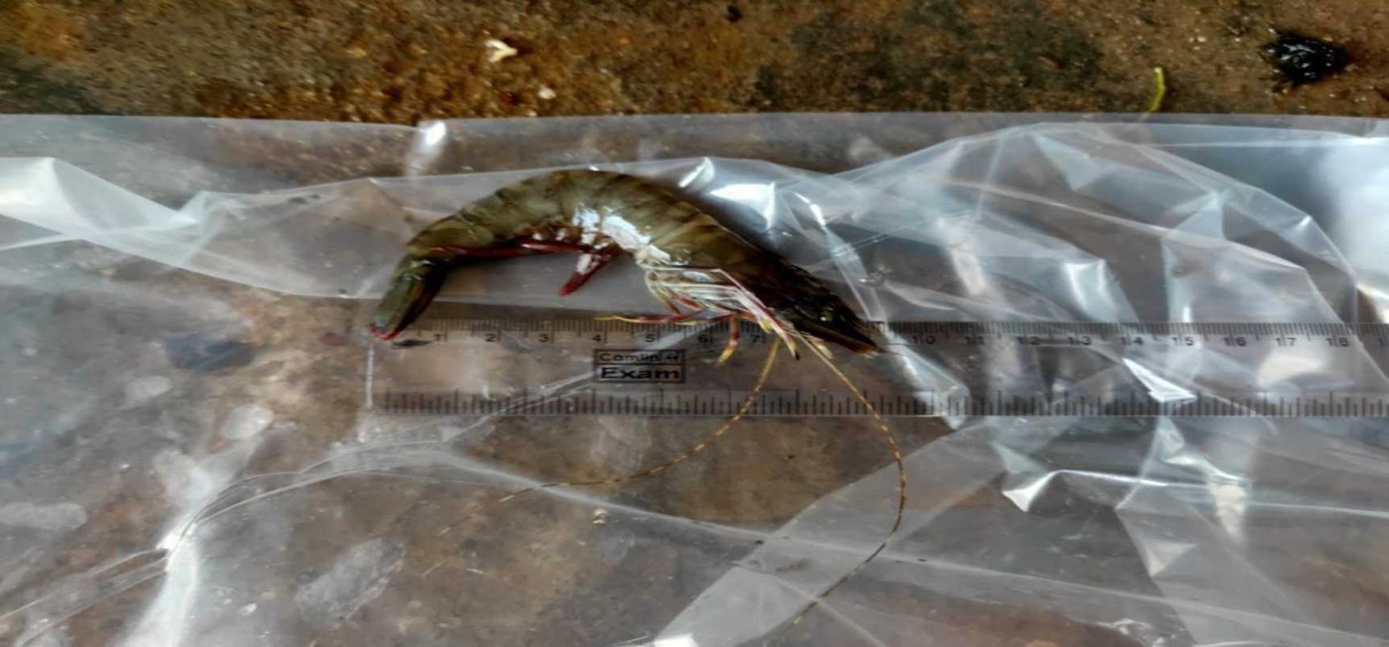
Penaeus monodon

Slide 44
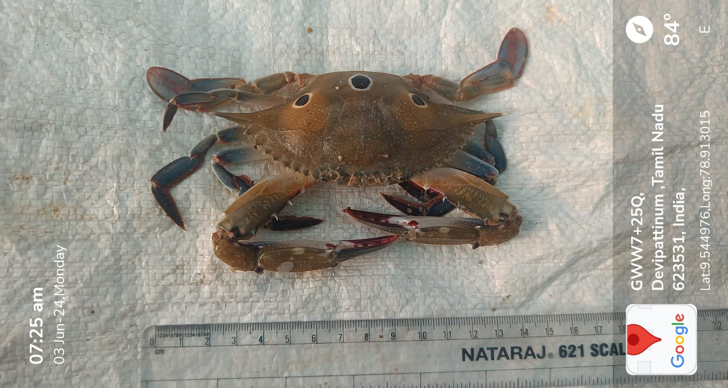
Portunus sanguinolentus

Slide 45
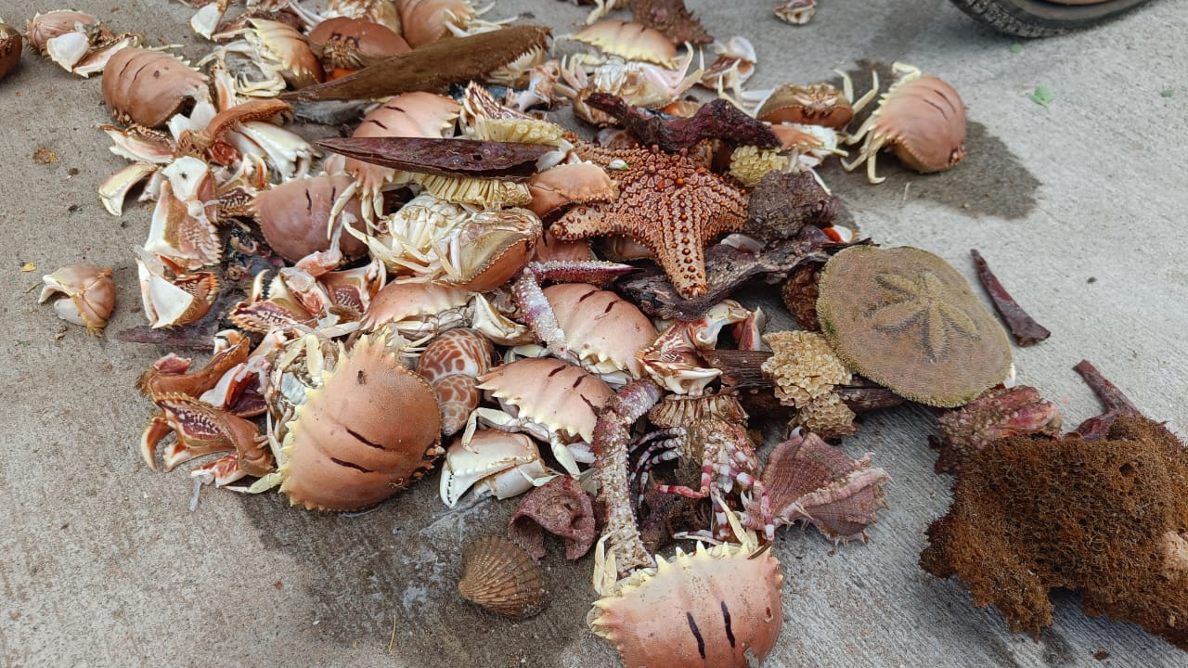
Biscuit Crab

Slide 46
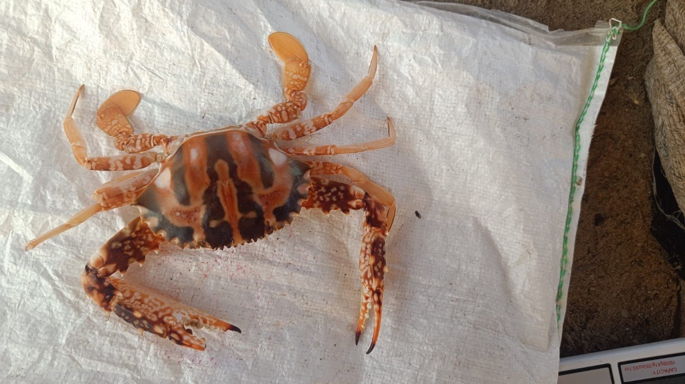
Charybdis feriata

Slide 47
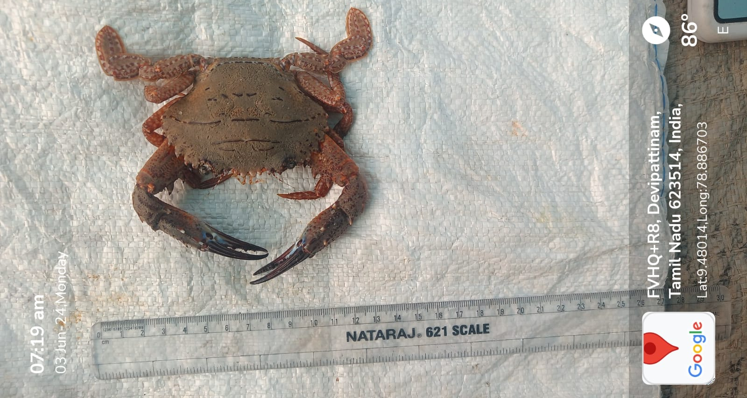
Charybdis natator

Slide 48
SPECIES WEIGHT
No. | SPECIES | WEIGHT/Gm
1 | Scatophagus argus | 150 - 180
2 | Scomberoides commersonianus | 500 - 580
3 | Trachinotus mookale | 450 - 530
4 | Brevitrygon imbricata | 180 - 220
5 | Chiloscyllium griseum | 210 - 250
6 | Cynoglossus broadhursti | 75 - 90
7 | Sillago sihama | 60 - 70
8 | caranx sexfaciatus | 210-270
9 | siganus javus | 200-300
10 | scatophagus argus | 238-250
11 | Echinodermata | 06 to 08
12 | Terebra nebulosa | 04 to 05
13 | Thais bufo | 06 to 07
14 | Marginella angustata | 10 to 12
15 | Lambis chiragra arthritis | 30 - 35
16 | Harpulina lapponica | 12 - 14
17 | Fasciolaria filamentosa | 63 - 80
18 | Aluterus monoceros | 200 - 290

Slide 49
ETP species found in the Region

Slide 50
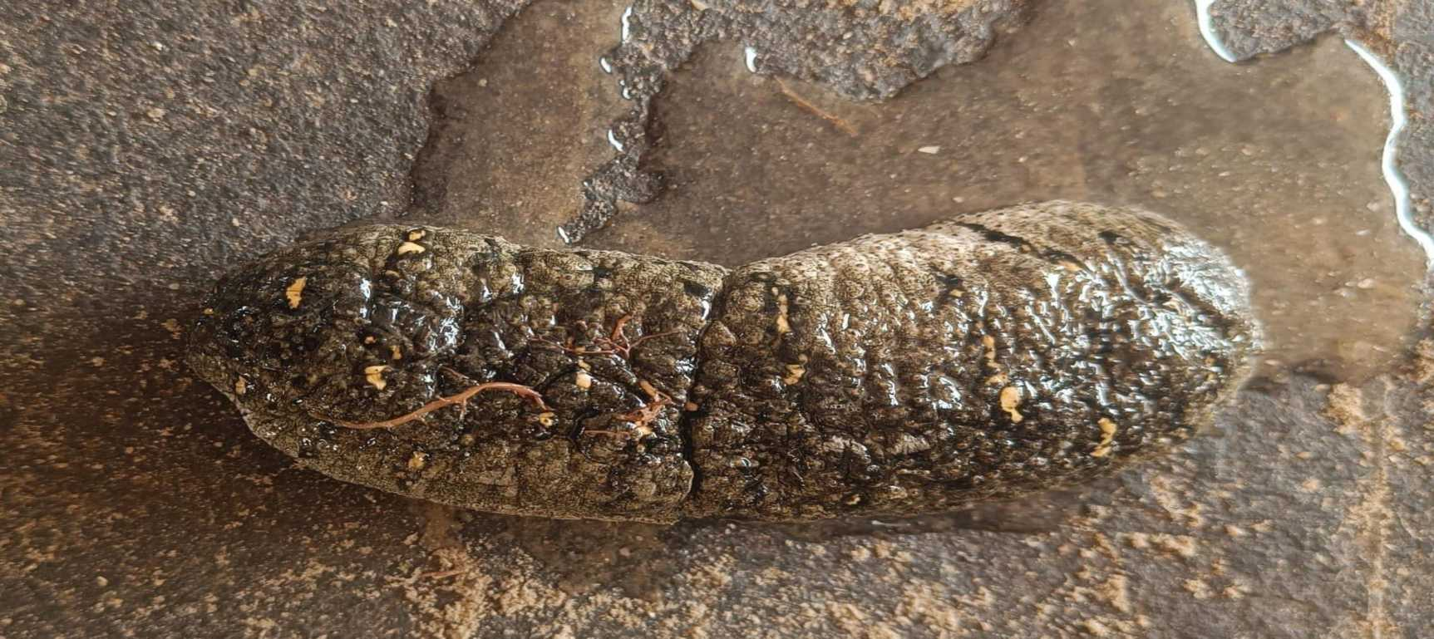
Holothuria scabra

Slide 51
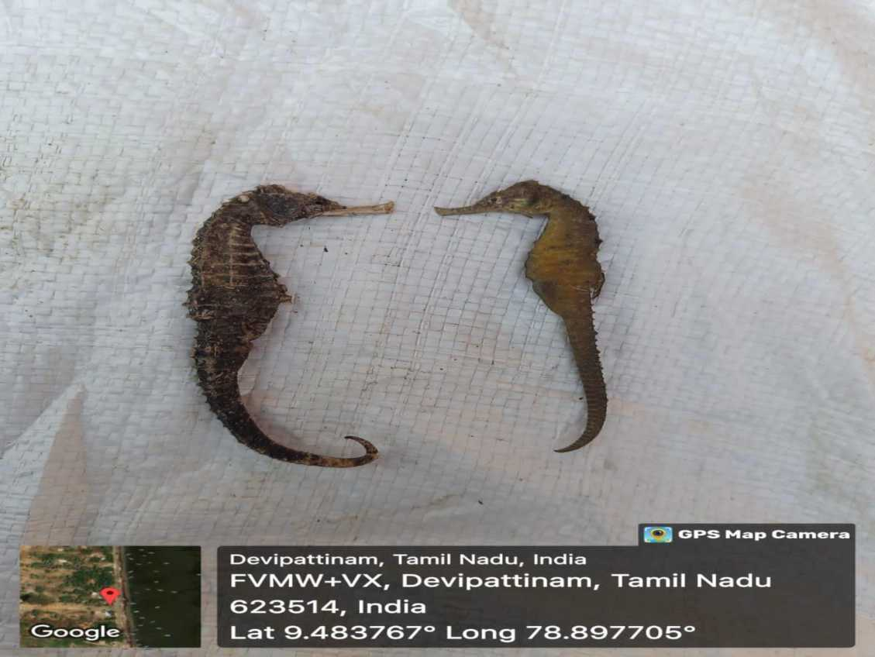
Hippocampus kellogi (left) and Hippocampus kuda (right)

Slide 52
Sea Grass

Slide 53
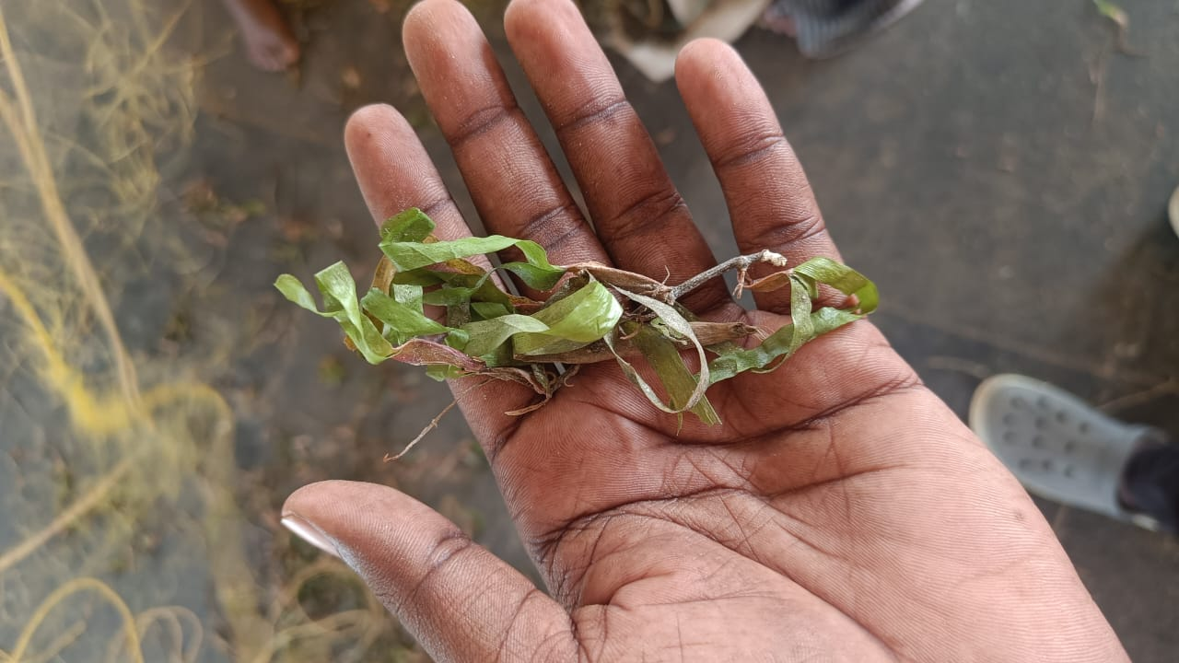
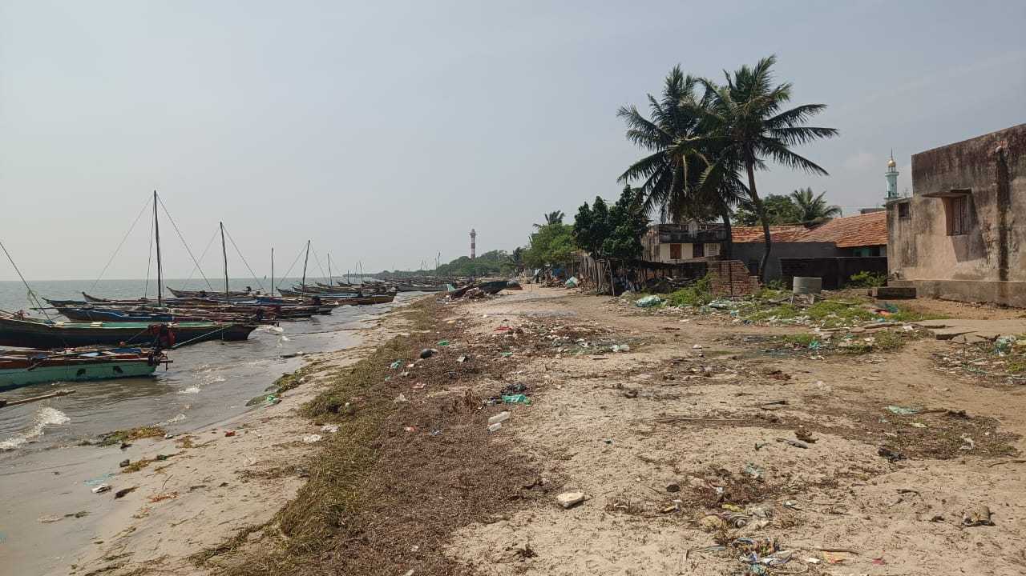
Karumpul
Semppul

Slide 54
Sempati
Karnjempati
Karumpul
Semppul
Oolai Passi or Ollai pul
Sea Grass Types

Slide 55




ETP SPECIES

Slide 56



Slide 57
THANK YOU

